Slide 1


Manipulating AN INDIAN POLITICIAN’s TWEET IS WORRINGLY EASY TO DO SO !!! (Manipulating Tweets Of Ruling Indian Political Party's IT Cell)
Mohammed Nauman Siddique
Web Archiving Forensics (CS 895)
Spring, 2019
Web Science and Digital Libraries Group
Old Dominion University
Norfolk, Virginia, USA
@WebSciDL
02/27/2019

Slide 2
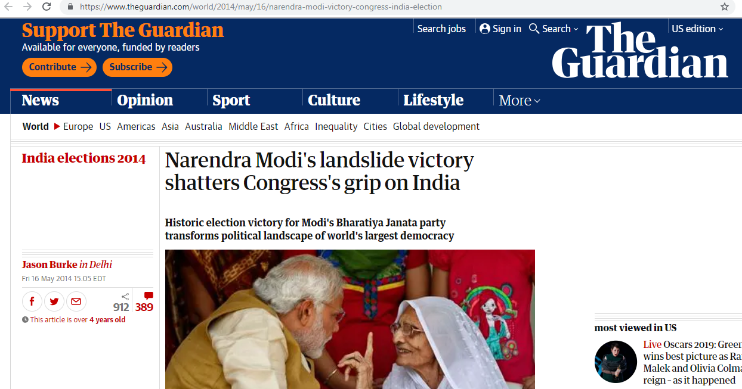
Bhartiya Janta Party (BJP) wins 2014 Indian Parliamentary Elections
Source: https://www.theguardian.com/world/2014/may/16/narendra-modi-victory-congress-india-election

Slide 3
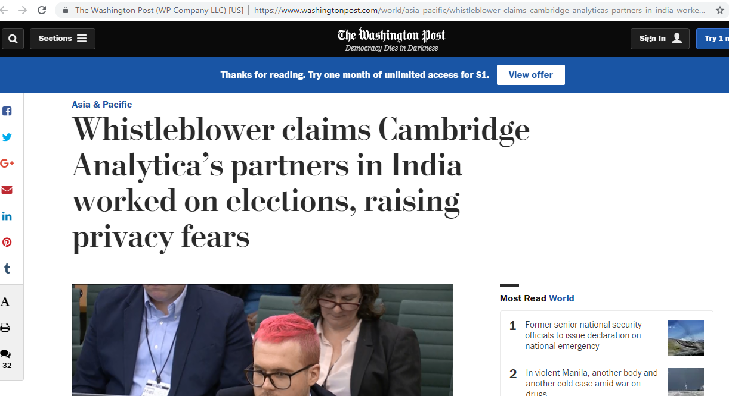
Remember Cambridge Analytica and Facebook story!!!
Source: https://www.washingtonpost.com/world/asia_pacific/whistleblower-claims-cambridge-analyticas-partners-in-india-worked-on-elections-raising-privacy-fears/2018/03/28/1168c04c-328a-11e8-b6bd-0084a1666987_story.html

Slide 4
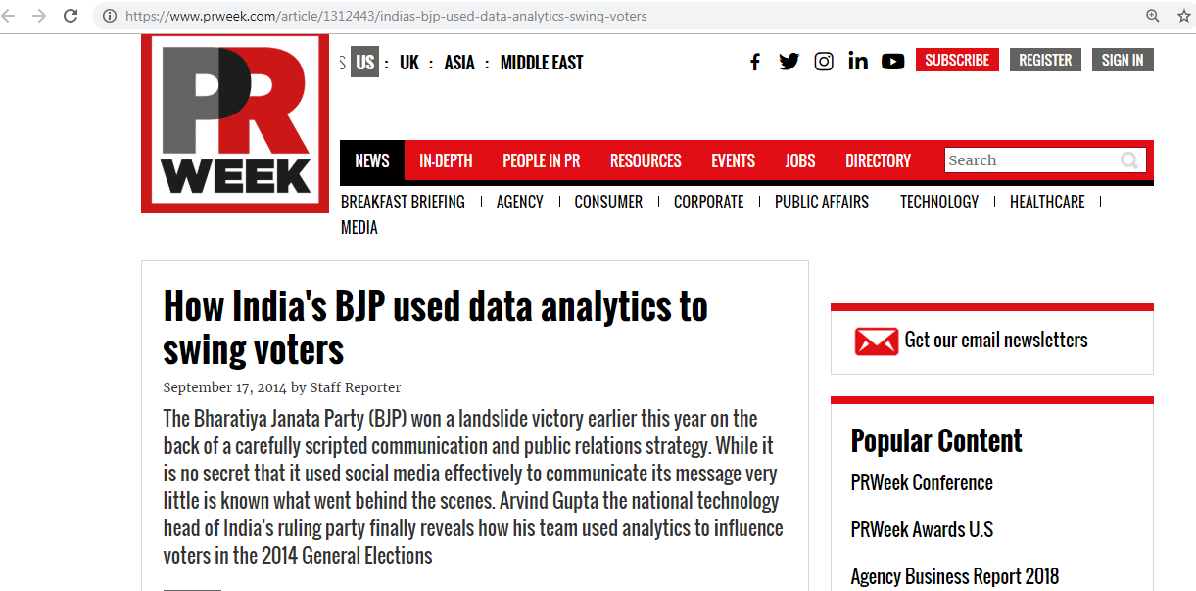
Social Media’s impact on 2014 Indian Parliamentary Elections
Source: https://www.prweek.com/article/1312443/indias-bjp-used-data-analytics-swing-voters

Slide 5
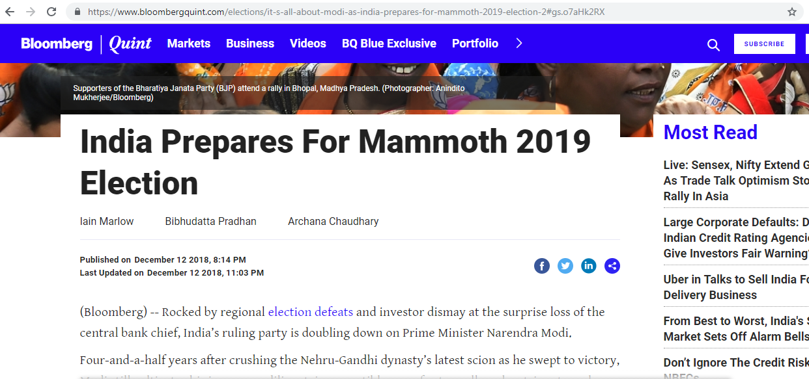
2019 Indian Parliamentary Elections are around the corner!!!
Source: https://www.bloombergquint.com/elections/it-s-all-about-modi-as-india-prepares-for-mammoth-2019-election-2

Slide 6
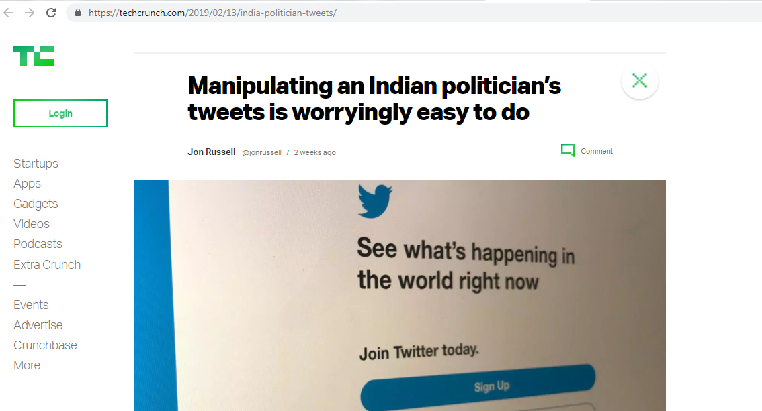
Manipulating an Indian politician’s tweets (February 13, 2019)
News Article: https://techcrunch.com/2019/02/13/india-politician-tweets/

Slide 7
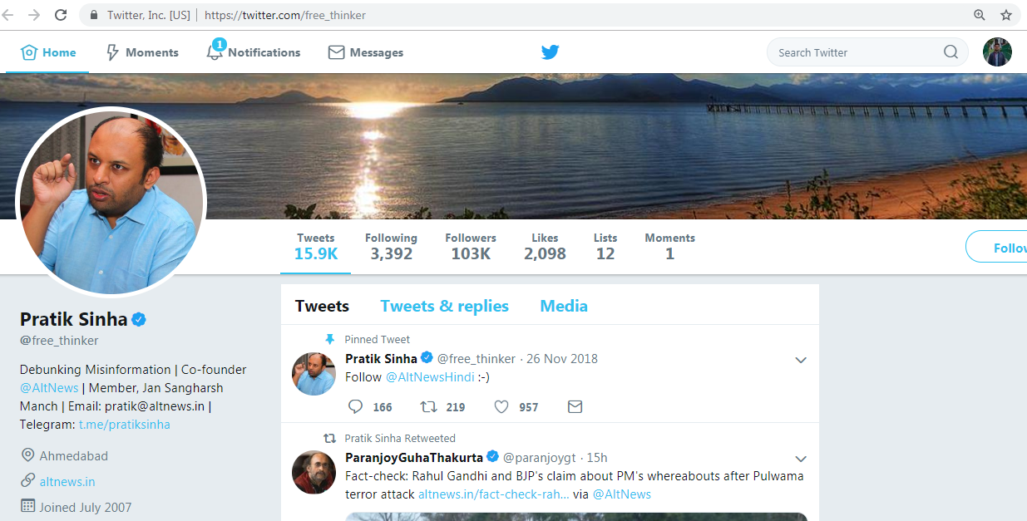
Pratik Sinha broke the story
Source: https://twitter.com/free_thinker

Slide 8
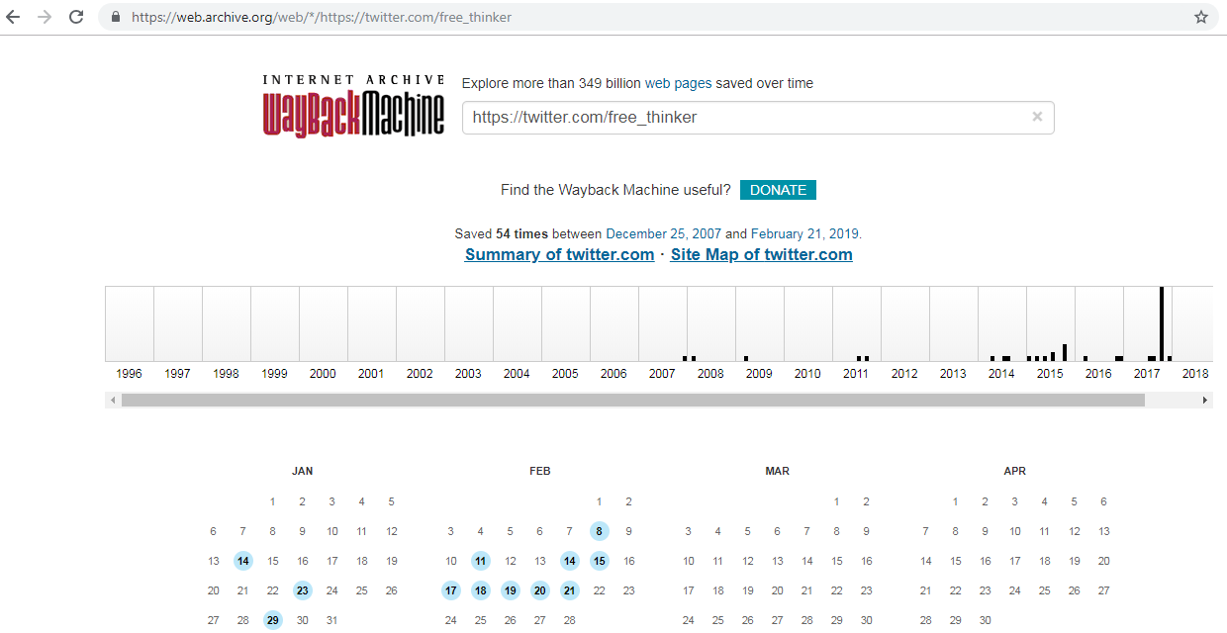
@free_thinker was archived
Archived 54 times
He tweeted his content on 12th of February, 2019
Source: https://web.archive.org/web/*/https://twitter.com/free_thinker

Slide 9
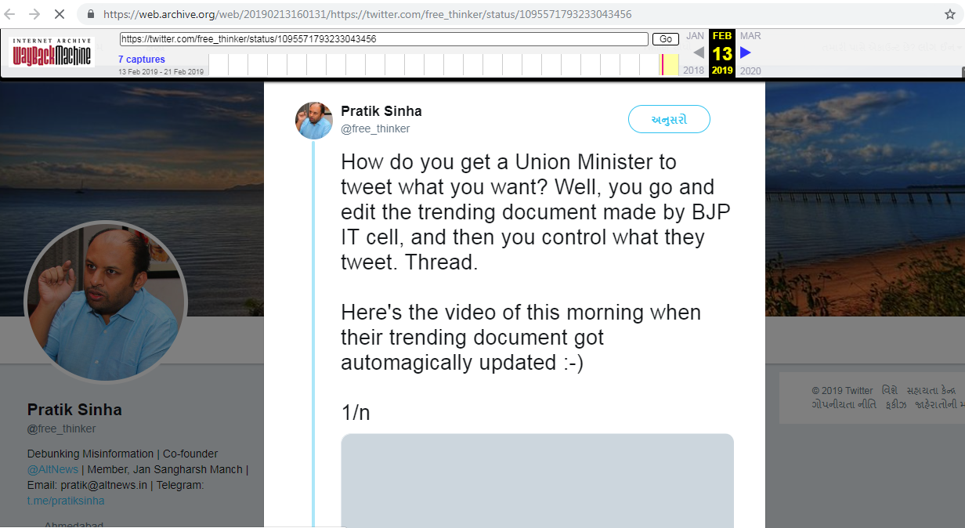
Hurray…. The whole thread is archived!!!
Source: https://web.archive.org/web/20190213160131/https://twitter.com/free_thinker/status/1095571793233043456

Slide 10
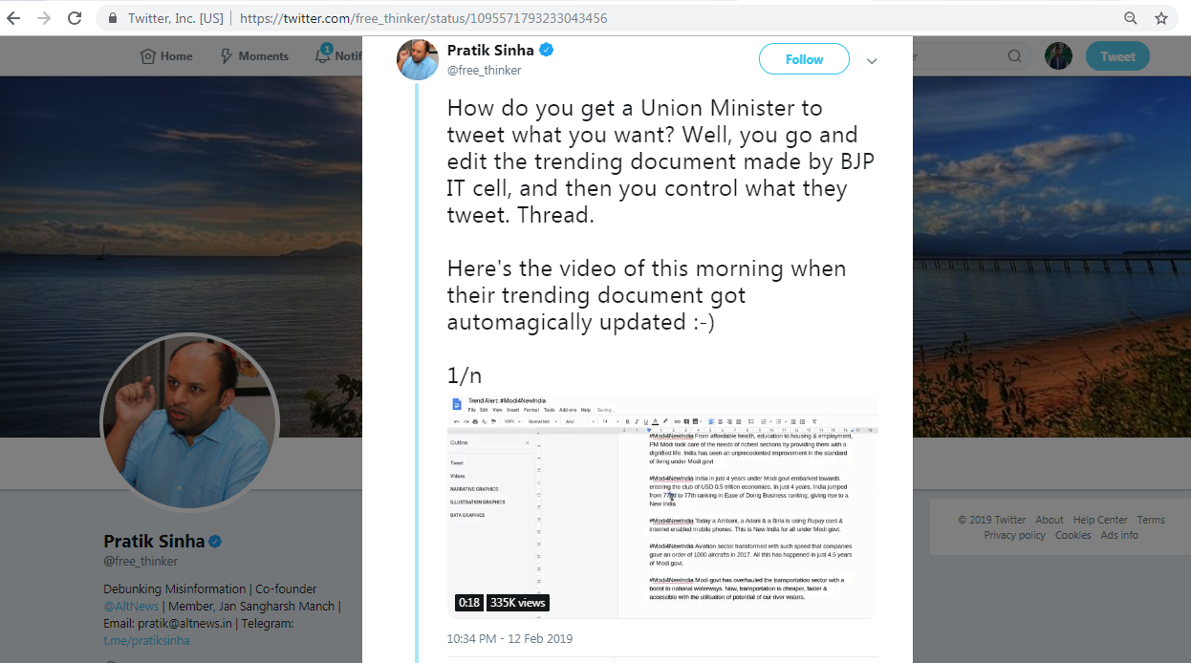
Copy n Paste Champions
Source: https://twitter.com/free_thinker/status/1095571793233043456

Slide 11
Handles which tweeted out the manipulated tweets
Twitter Handle | Description
@PonnaarrBJP | Union Minister of State for Finance and Shipping, Government of India
@BJP4Assam | Official Twitter Handle of BJP Assam
@iSureshBjp | MLA (State Representative)
@bk_chudasama | Co-convener BJP IT CELL, Followed by Prime Minister @narendramodi
@rakasera | District Organizer BJP IT Cell, Bhilwara
@iHirenShukla | North Zone Head, BJP ITSM
@ImashishjhaAj | Followed by National Secretary of BJP @RahulsinhaBJP
@mahindrbahubali | Account deleted
@SarmahAimani | Poet & Freelance writer (Joined September 2018)
@Lakshya2019 | A campaign account
@prangshudeb | Nationalist | Anti-Naxalist | Computer Engineer | IT Professional | Traveller | IndiaLover
Part of the BJP Party
Part of the BJP IT Cell

Slide 12
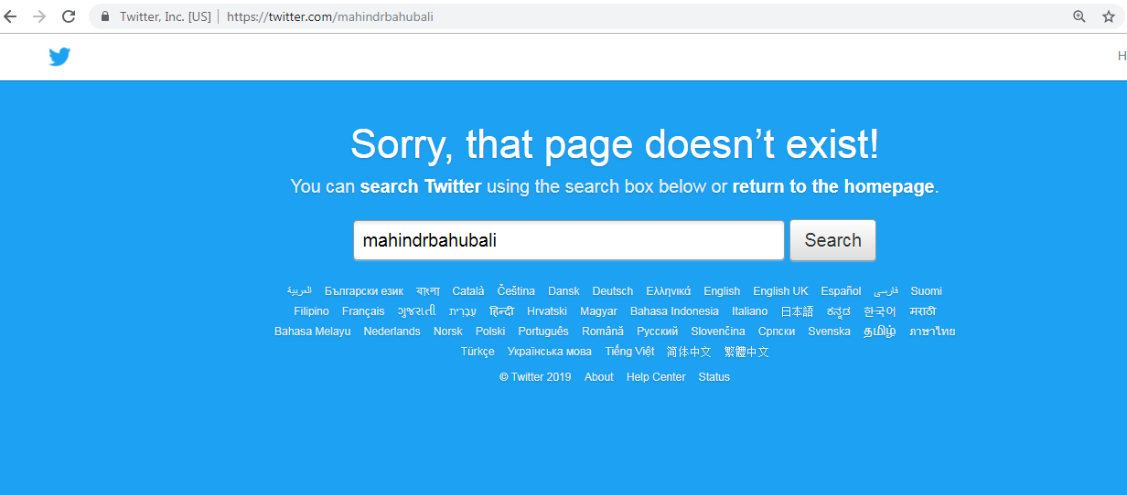
Deleted account courtesy of @mahindrbahubali
Source: https://twitter.com/mahindrbahubali

Slide 13
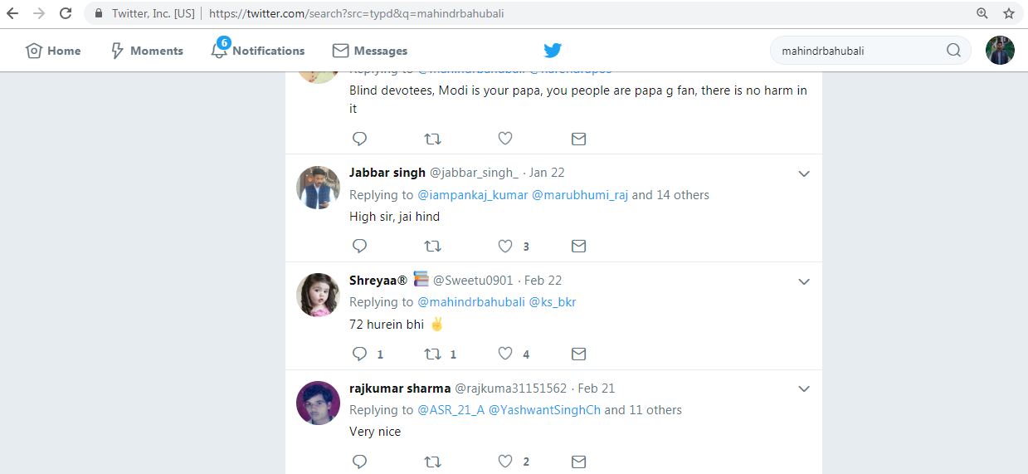
Account was live on February 22, 2019
Source: https://twitter.com/search?src=typd&q=mahindrbahubali

Slide 14
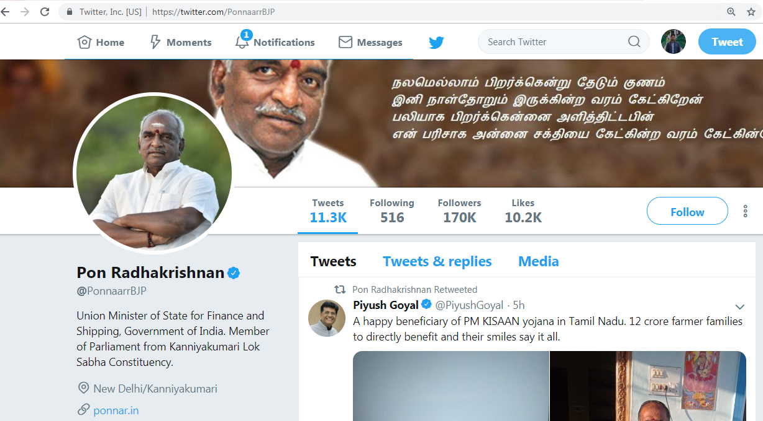
Union Minister for Finance and Shopping
Source: https://twitter.com/PonnaarrBJP

Slide 15
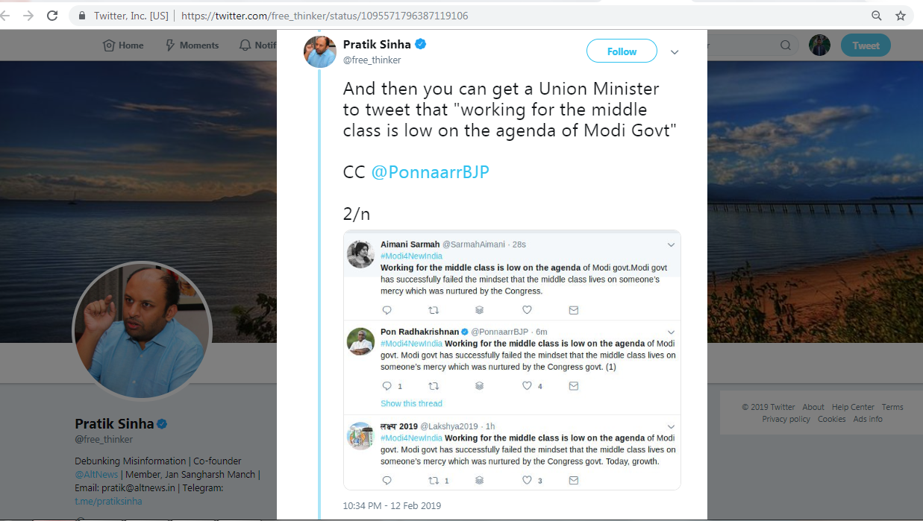
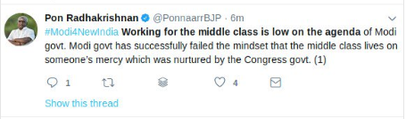
A minister blaming his own government for failing on middle class agenda
Enlarged View
Source: https://twitter.com/free_thinker/status/1095571796387119106

Slide 16
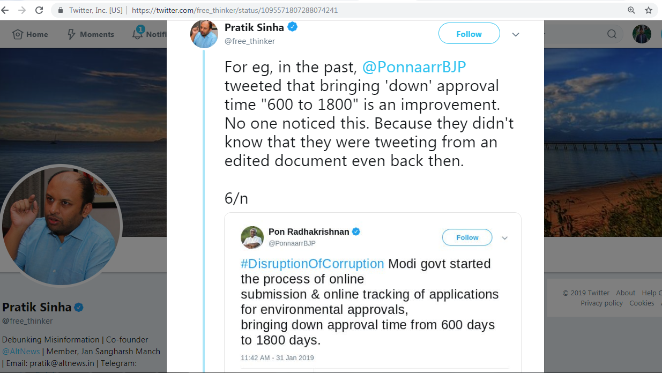
Another funny tweet from the minister
Source: https://twitter.com/free_thinker/status/1095571807288074241

Slide 17
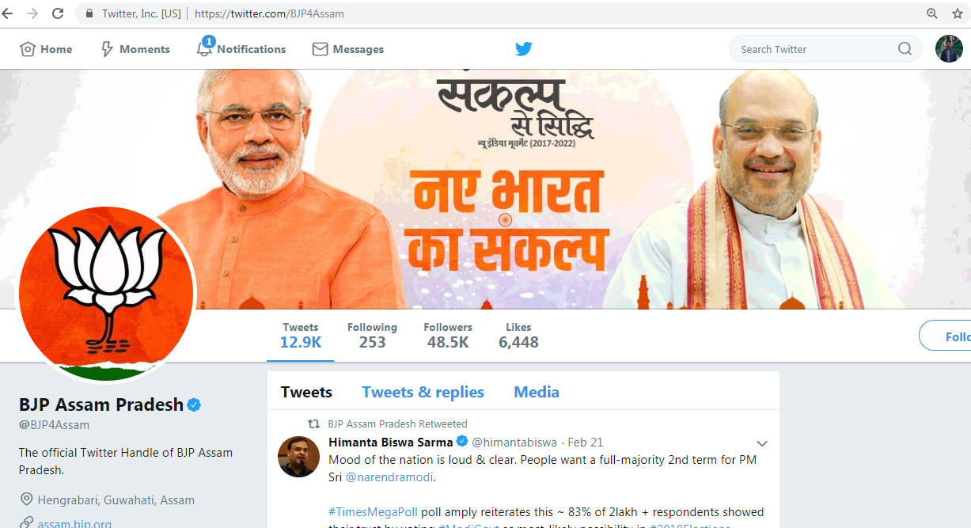
BJP Assam Official Twitter Page
Source: https://twitter.com/BJP4Assam

Slide 18
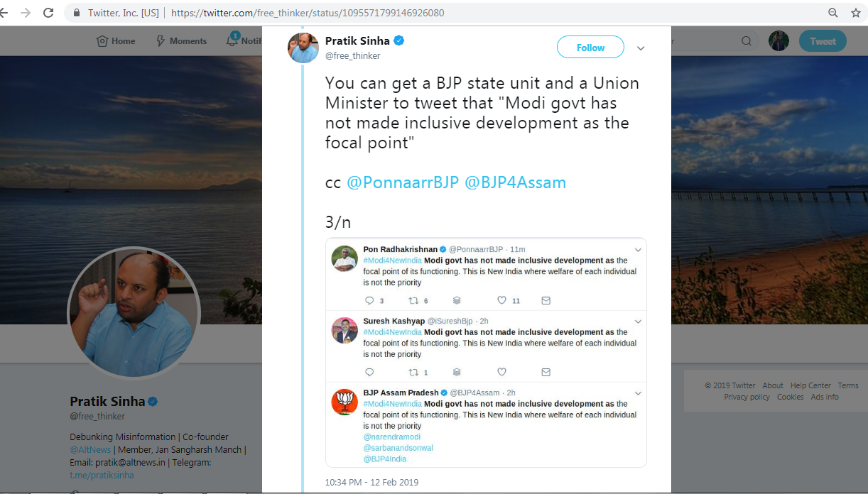
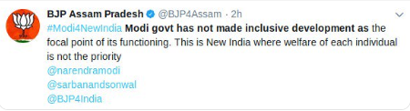
Official state unit handle criticizes its own government
Enlarged View
Source: https://twitter.com/free_thinker/status/1095571799146926080

Slide 19
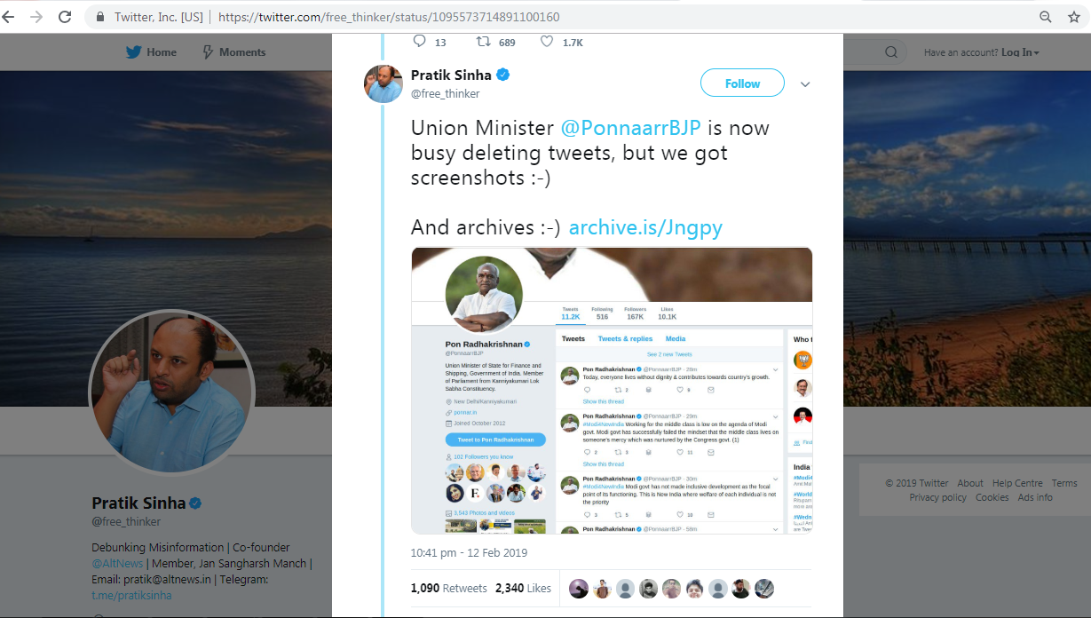
@PonnaarrBJP tweets pushed to archive.is
Source: https://twitter.com/free_thinker/status/1095573714891100160

Slide 20
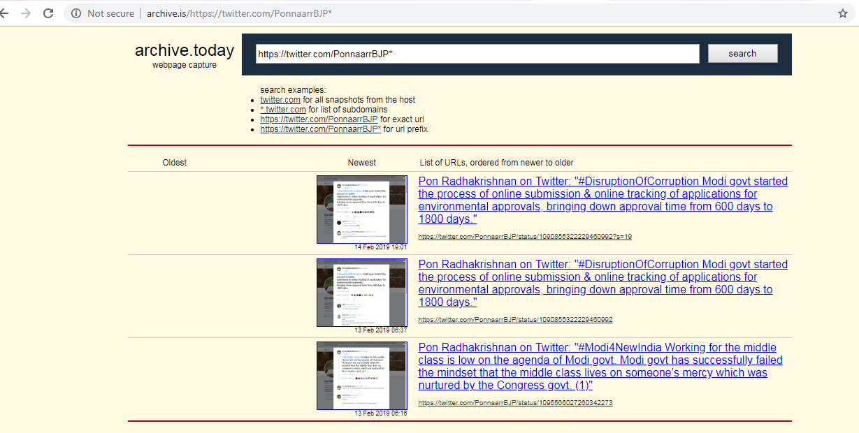
2 tweets for @PonnaarrBJP archived at Archive.is
Both the tweets are from the manipulated tweet story.
Source: http://archive.is/https://twitter.com/PonnaarrBJP*

Slide 21
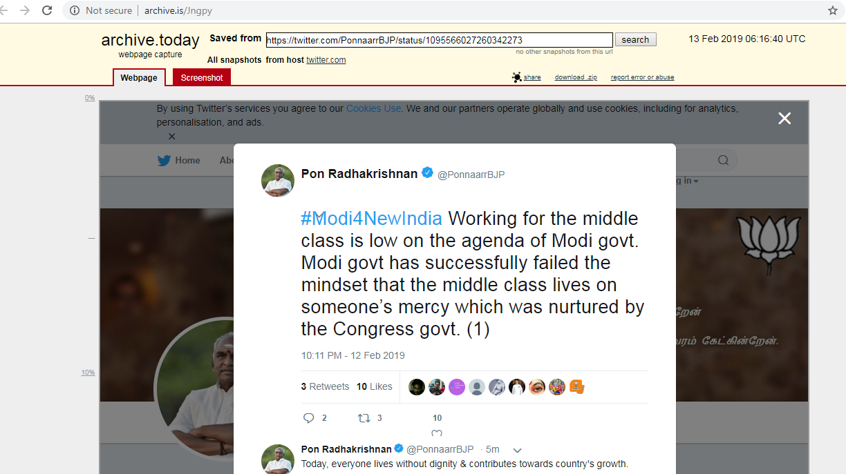
One of the tweets from the news article
Source: http://archive.is/Jngpy

Slide 22
One tweets is live on the web but another is 404
msiddique@atria:~$ curl -I https://twitter.com/PonnaarrBJP/status/1095566027260342273
HTTP/1.1 404 Not Found
cache-control: no-cache, no-store, must-revalidate, pre-check=0, post-check=0
content-length: 6329
msiddique@atria:~$ curl -I https://twitter.com/PonnaarrBJP/status/1090855322229460992
HTTP/1.1 200 OK
cache-control: no-cache, no-store, must-revalidate, pre-check=0, post-check=0
content-length: 445108
…Deletia..
msiddique@atria:~$ curl -I https://twitter.com/PonnaarrBJP/status/1095566027260342273
HTTP/1.1 404 Not Found
cache-control: no-cache, no-store, must-revalidate, pre-check=0, post-check=0
content-length: 6329
... Deletia...

Slide 23
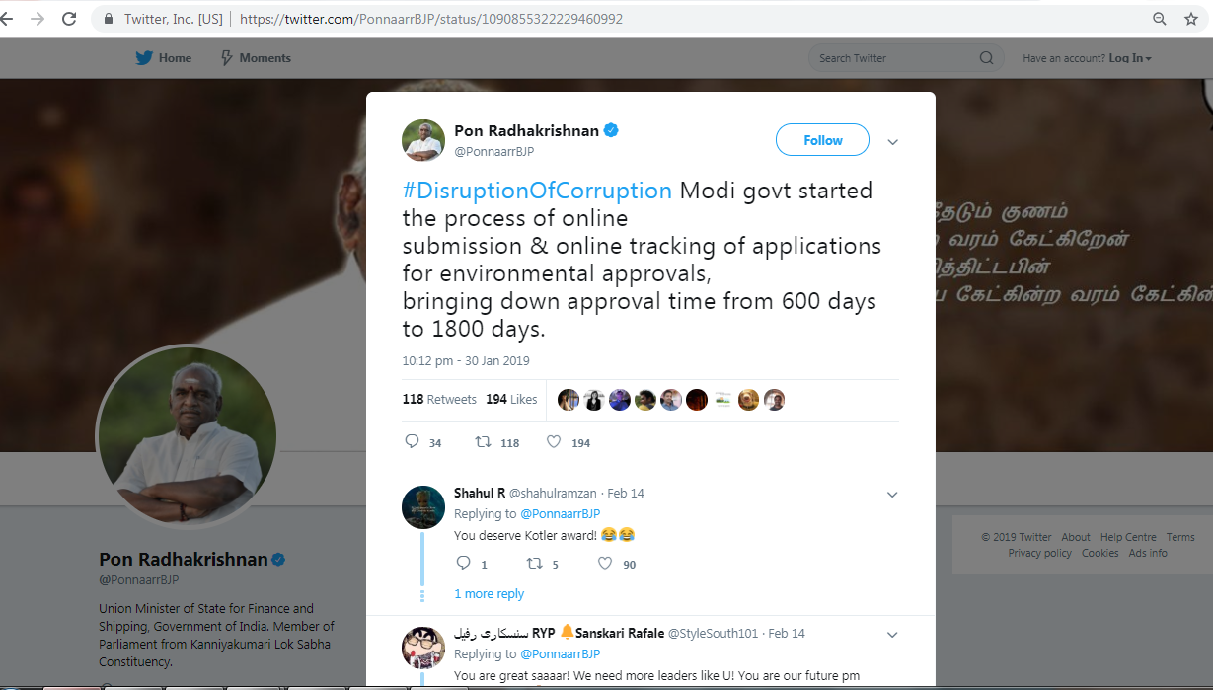
Live Tweet from @PonnaarrBJP
Source: https://twitter.com/PonnaarrBJP/status/1090855322229460992

Slide 24
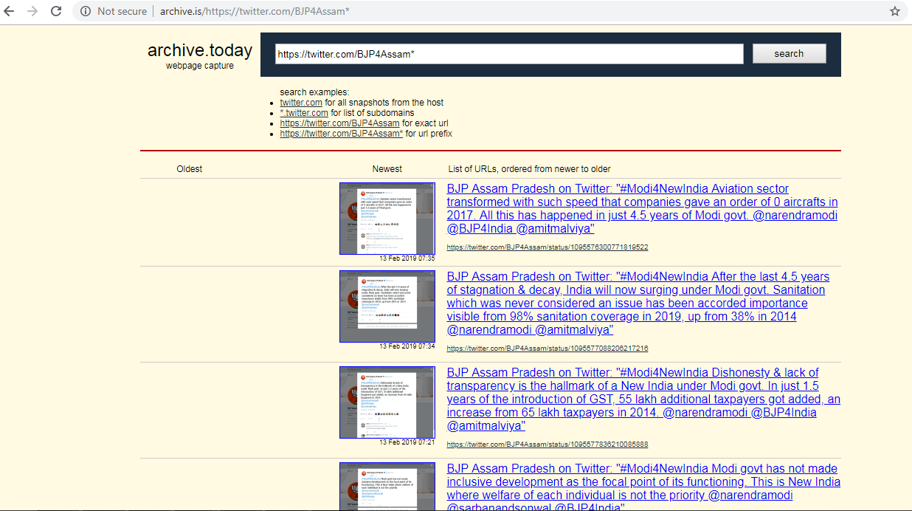
5 tweets for @BJP4Assam archived at archive.is
All of the four tweets related to
manipulated tweet story are deleted.
Source: http://archive.is/https://twitter.com/BJP4Assam*

Slide 25
Archive.is has 4 deleted and 1 live tweet for @BJP4Assam
https://twitter.com/BJP4Assam/status/1095576300771819522 (Deleted) [Relevant to story]
https://twitter.com/BJP4Assam/status/1095577088206217216 (Deleted) [Relevant to story]
https://twitter.com/BJP4Assam/status/1095577836210085888 (Deleted) [Relevant to story]
https://twitter.com/BJP4Assam/status/1095542253987086336 (Deleted) [Relevant to story]
https://twitter.com/BJP4Assam/status/1078600314952003585 (Live on the web) [Not relevant to story]

Slide 26
Archive.is archival coverage for manipulated story related Twitter handles
@Lakshya2019 has two captures not relevant to the manipulated tweet story, while the rest of the Twitter accounts are not archived in archive.is.
It is most plausible that someone manually pushed the tweets referred in the story to archive.is.

Slide 27
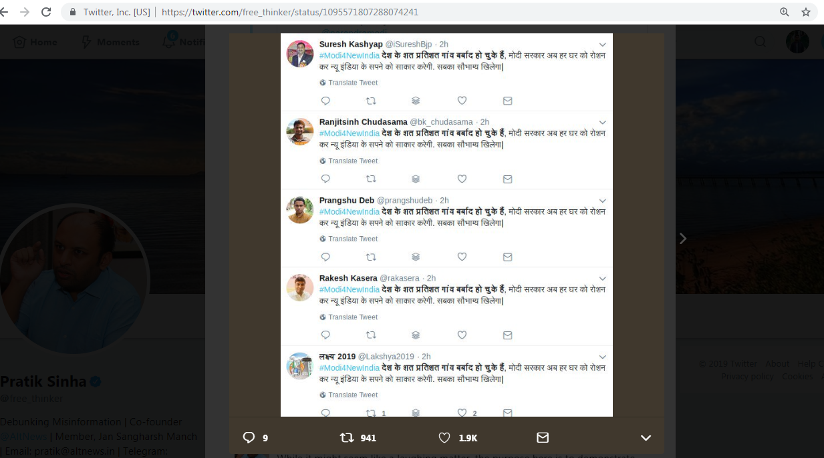
Better to have both the Tweet URLs and screenshots for a tweet
Tweet URLs help differentiate between live and deleted tweets over the screenshots.
Push the controversial tweets to multiple archives. (Use Archive Now tool)
Source: https://twitter.com/free_thinker/status/1095571807288074241
Archive Now: https://ws-dl.blogspot.com/2017/02/2017-02-22-archive-now-archivenow.html

Slide 28
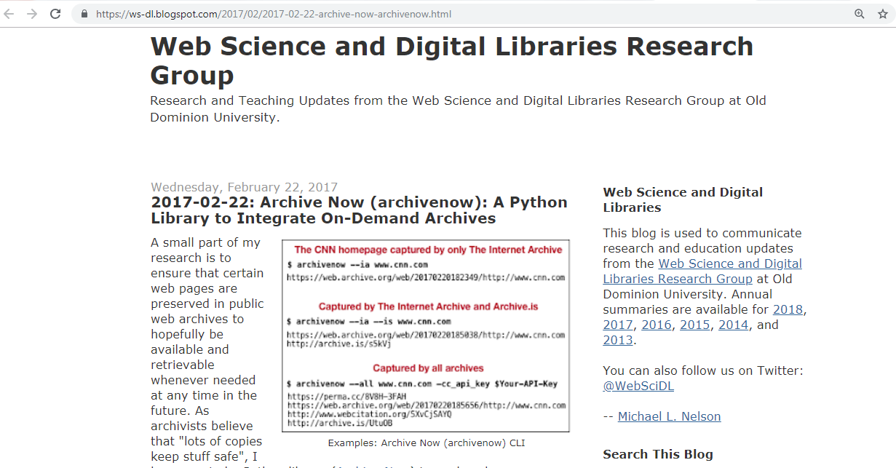
Push your tweets to multiple archives
Source: https://ws-dl.blogspot.com/2017/02/2017-02-22-archive-now-archivenow.html

Slide 29
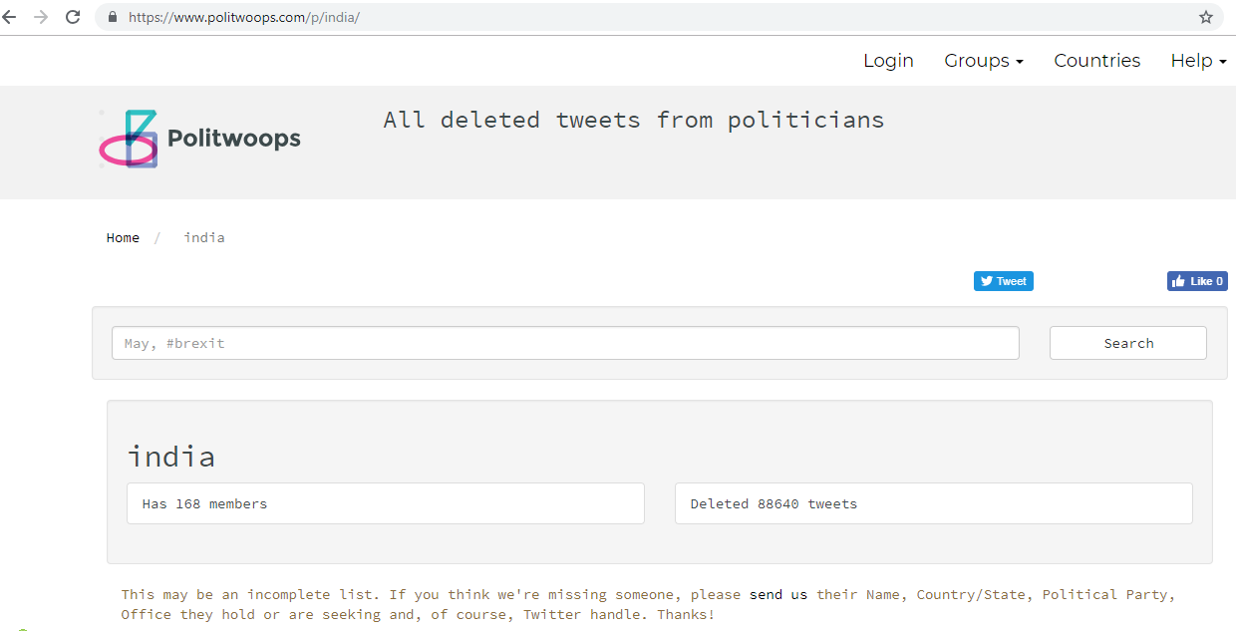
Politwoops India: Tracks deleted tweets for politicians
168 members out of 790 Members of Parliament.
(It is an incomplete list. Missing handles need to be
sent to Politwoops)
Source: https://www.politwoops.com/p/india/

Slide 30
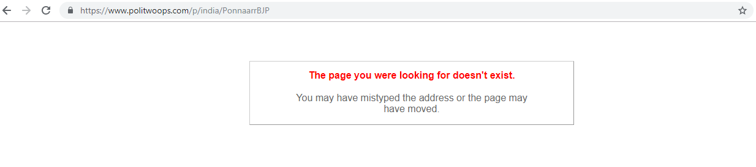
Union Minister’s Twitter handle (@PonnaarrBJP) is missing from Politwoops India
Source: https://www.politwoops.com/p/india/PonnaarrBJP

Slide 31
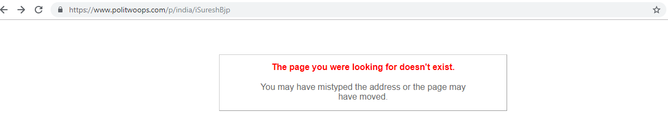
State representative's Twitter handle is missing from Politwoops India (Not a surprise!!!)
Source: https://www.politwoops.com/p/india/iSureshBjp

Slide 32
Politwoops India has no information for us. Now let’s check the web archives (except archive.is).

Slide 33
Memento Count for all the Twitter handles
Memento Count | Twitter Handle
0 | @iSureshBjp, @ImashishjhaAj, @rakasera , @iHirenShukla, @mahindrbahubali, @SamrahAimani, @prangshudeb
1 | @BJP4Assam
2 | @Lakshya2019
3 | @bk_chudasama
7 | @PonnarrBJP
Party’s official account
Union Minister’s account

Slide 34
@PonnarrBJP TimeMap (7 Mementos)
msiddique@msiddique-XPS-13-9360:~$ curl http://localhost:1208/timemap/cdxj/https://twitter.com/PonnaarrBJP
….Deletia….
20190107045908 {"uri": "http://web.archive.org/web/20190107045908/https://twitter.com/PonnaarrBJP", "rel": "first memento", "datetime": "Mon, 07 Jan 2019 04:59:08 GMT"}
20190214091551 {"uri": "http://web.archive.org/web/20190214091551/https://twitter.com/ponnaarrbjp", "rel": "memento", "datetime": "Thu, 14 Feb 2019 09:15:51 GMT"}
20190215073055 {"uri": "http://web.archive.org/web/20190215073055/https://twitter.com/ponnaarrbjp", "rel": "memento", "datetime": "Fri, 15 Feb 2019 07:30:55 GMT"}
20190218101106 {"uri": "http://web.archive.org/web/20190218101106/https://twitter.com/ponnaarrbjp", "rel": "memento", "datetime": "Mon, 18 Feb 2019 10:11:06 GMT"}
20190219103324 {"uri": "http://web.archive.org/web/20190219103324/https://twitter.com/ponnaarrbjp", "rel": "memento", "datetime": "Tue, 19 Feb 2019 10:33:24 GMT"}
20190220114539 {"uri": "http://web.archive.org/web/20190220114539/https://twitter.com/ponnaarrbjp", "rel": "memento", "datetime": "Wed, 20 Feb 2019 11:45:39 GMT"}
20190221140602 {"uri": "http://web.archive.org/web/20190221140602/https://twitter.com/ponnaarrbjp", "rel": "last memento", "datetime": "Thu, 21 Feb 2019 14:06:02 GMT"}

Slide 35
No memento captures the 12th February, 2019 tweet fiasco
msiddique@msiddique-XPS-13-9360:~$ curl http://localhost:1208/timemap/cdxj/https://twitter.com/PonnaarrBJP
….Deletia….
20190107045908 {"uri": "http://web.archive.org/web/20190107045908/https://twitter.com/PonnaarrBJP", "rel": "first memento", "datetime": "Mon, 07 Jan 2019 04:59:08 GMT"}
20190214091551 {"uri": "http://web.archive.org/web/20190214091551/https://twitter.com/ponnaarrbjp", "rel": "memento", "datetime": "Thu, 14 Feb 2019 09:15:51 GMT"}
20190215073055 {"uri": "http://web.archive.org/web/20190215073055/https://twitter.com/ponnaarrbjp", "rel": "memento", "datetime": "Fri, 15 Feb 2019 07:30:55 GMT"}
….Deletia…

Slide 36
@BJP4Assam TimeMap (1 Memento)
msiddique@msiddique-XPS-13-9360:~$ curl http://localhost:1208/timemap/cdxj/https://twitter.com/BJP4Assam
@context ["http://tools.ietf.org/html/rfc7089"]
@id {"uri": "http://localhost:1208/timemap/cdxj/https://twitter.com/BJP4Assam"}
@keys ["memento_datetime_YYYYMMDDhhmmss"]
@meta {"original_uri": "https://twitter.com/BJP4Assam"}
@meta {"timegate_uri": "http://localhost:1208/timegate/https://twitter.com/BJP4Assam"}
….Deletia….
20190213082005 {"uri": "http://web.archive.org/web/20190213082005/https://twitter.com/BJP4Assam", "rel": "first last memento", "datetime": "Wed, 13 Feb 2019 08:20:05 GMT"}

Slide 37
@bk_chudasama TimeMap (3 Mementos)
msiddique@msiddique-XPS-13-9360:~$ curl http://localhost:1208/timemap/cdxj/https://twitter.com/bk_chudasama
@context ["http://tools.ietf.org/html/rfc7089"]
@id {"uri": "http://localhost:1208/timemap/cdxj/https://twitter.com/bk_chudasama"}
@keys ["memento_datetime_YYYYMMDDhhmmss"]
@meta {"original_uri": "https://twitter.com/bk_chudasama"}
…Deletia…
20150902173824 {"uri": "http://web.archive.org/web/20150902173824/http://twitter.com/bk_chudasama", "rel": "first memento", "datetime": "Wed, 02 Sep 2015 17:38:24 GMT"}
20150902173825 {"uri": "http://web.archive.org/web/20150902173825/https://twitter.com/bk_chudasama", "rel": "memento", "datetime": "Wed, 02 Sep 2015 17:38:25 GMT"}
20180330072227 {"uri": "http://web.archive.org/web/20180330072227/https://twitter.com/bk_chudasama", "rel": "last memento", "datetime": "Fri, 30 Mar 2018 07:22:27 GMT"}
No memento from 2019

Slide 38
Web archives (except archive.is) do not have enough mementos to provide us with any tweet deletion evidence.

Slide 39
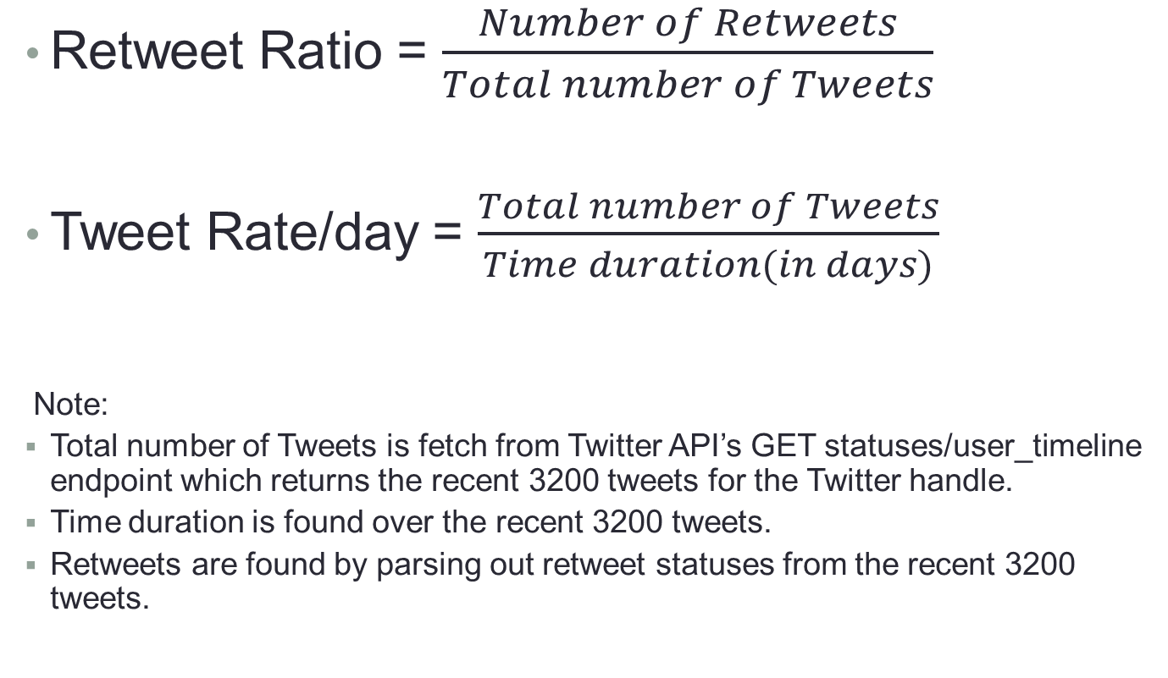
Tweet Rate/day and Retweet Ratio explained
Retweet Ratio = $\frac{Number of Retweets}{Total number of Tweets}$
Tweet Rate/day = $\frac{Total number of Tweets}{Time duration(in days)}$
Note:
Total number of Tweets is fetch from Twitter API’s GET statuses/user_timeline endpoint which returns the recent 3200 tweets for the Twitter handle.
Time duration is found over the recent 3200 tweets.
Retweets are found by parsing out retweet statuses from the recent 3200 tweets.
Source: https://developer.twitter.com/en/docs/tweets/timelines/api-reference/get-statuses-user_timeline.html

Slide 40
@bk_chudasama tweets a lot of original content
Twitter Handle | Retweet Ratio | Tweet Rate/day | Tweet Count | Tweet fetched from Twitter API
PonnaarrBJP | 0.34 | 22.27 | 11320 | 3235
BJP4Assam | 0.70 | 138.47 | 13071 | 3255
iHirenShukla | 0.92 | 273.06 | 18589 | 3249
bk_chudasama | 0.10 | 2273.25 | 81757 | 3245
prangshudeb | 0.44 | 14.38 | 8923 | 3237
rakasera | 0.069 | 64.25 | 8938 | 3246
ImashishjhaAj | 0.61 | 1.78 | 2206 | 2044
SarmahAimani | 0.98 | 16.25 | 2632 | 2589
Lakshya2019 | 0.30 | 290.42 | 70908 | 3227
iSureshBjp | 0.41 | 2.49 | 730 | 733
Note: Retweet Ratio and Tweet Rate calculated over recent 3200 tweets fetched from Twitter API

Slide 41
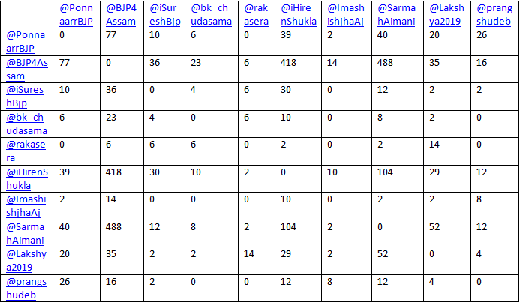
Matrix representation of identical tweets between different accounts

Slide 42
Top 10 most retweeted handles found in our dataset
Twitter Handle | Description
@narendramodi | Prime Minister of India
@BJP4India | Official account of BJP
@BJP4Gujarat | Official account of BJP Gujrat (a state)
@AmitShah | BJP Party President
@PMOIndia: | Prime Minister’s Office
@Sarbanandsonwal | Chief Minister of Assam (a state)
@Himantabiswa: | Minister from Assam
@BJP4Assam | Official account of BJP Assam
@CMOfficeAssam | Assam Chief Minister’s Office
@DDNewsLive | Government News Channel
Handle which tweeted the manipulated tweets

Slide 43
53% of retweets are from top 10 handles
Total Tweets fetched using Twitter API | 28113
Count of Retweet handles | 1276
Total Retweets | 13705
Top 10 Retweet handles count | 7197 (52.51%)
Top 20 Retweet handles count | 8307 (60.6%)
Top 50 Retweet handles count | 9763 (71.24%)
Top 250 Retweet handles count | 12055 (87.96%)
Top 500 Retweet handles count | 12822 (93.56%)

Slide 44
Key highlights from the analysis
Most of the tweets referred by @free_thinker in his tweet thread are deleted and also absent in the web archives.
None of the Twitter accounts have ample enough mementos in the web archives that can be used for deleted tweets analysis.
@bk_chudasama, co-convener of the BJP IT Cell, fell for the trap who tweets more than 2000 Tweets/day.
50% of the tweets are retweets with 52% of the retweets coming from top 10 retweeted handles.
Politwoops India misses out on the Twitter handle of Union Minister of India.

Slide 45
Takeaway (What have we learned?)
It is better to have both the Tweet URLs and screen shots of controversial tweets over a screen shot.
For finding deleted tweets, web archives work effectively for popular accounts but for less popular accounts this approach might not work.
It is easier to use Archive Now tool to push the tweets to multiple archives simultaneously over manually pushing it to each archive.
Politwoops India has an incomplete list of Twitter handles.

Slide 46
Backup Slides

Slide 47
@iSureshBjp TimeMap
msiddique@msiddique-XPS-13-9360:~$ curl -i http://localhost:1208/timemap/cdxj/https://twitter.com/iSureshBjp
HTTP/1.1 404 Not Found
Access-Control-Allow-Origin: *
Access-Control-Expose-Headers: Link, Location, X-Memento-Count, X-Generator
Content-Type: text/plain; charset=utf-8
X-Content-Type-Options: nosniff
X-Generator: MemGator:1.0-rc7
X-Memento-Count: 0
Date: Mon, 25 Feb 2019 03:51:38 GMT
Content-Length: 19
404 page not found

Slide 48
@ImashishjhaAj TimeMap
msiddique@msiddique-XPS-13-9360:~$ curl -i http://localhost:1208/timemap/cdxj/https://twitter.com/ImashishjhaAj
HTTP/1.1 404 Not Found
Access-Control-Allow-Origin: *
Access-Control-Expose-Headers: Link, Location, X-Memento-Count, X-Generator
Content-Type: text/plain; charset=utf-8
X-Content-Type-Options: nosniff
X-Generator: MemGator:1.0-rc7
X-Memento-Count: 0
Date: Mon, 25 Feb 2019 03:53:43 GMT
Content-Length: 19
404 page not found

Slide 49
@rakasera TimeMap
msiddique@msiddique-XPS-13-9360:~$ curl -i http://localhost:1208/timemap/cdxj/https://twitter.com/rakasera
HTTP/1.1 404 Not Found
Access-Control-Allow-Origin: *
Access-Control-Expose-Headers: Link, Location, X-Memento-Count, X-Generator
Content-Type: text/plain; charset=utf-8
X-Content-Type-Options: nosniff
X-Generator: MemGator:1.0-rc7
X-Memento-Count: 0
Date: Mon, 25 Feb 2019 03:53:43 GMT
Content-Length: 19
404 page not found

Slide 50
@mahindrbahubali TimeMap
msiddique@msiddique-XPS-13-9360:~$ curl -i http://localhost:1208/timemap/cdxj/https://twitter.com/mahindrbahubali
HTTP/1.1 404 Not Found
Access-Control-Allow-Origin: *
Access-Control-Expose-Headers: Link, Location, X-Memento-Count, X-Generator
Content-Type: text/plain; charset=utf-8
X-Content-Type-Options: nosniff
X-Generator: MemGator:1.0-rc7
X-Memento-Count: 0
Date: Mon, 25 Feb 2019 03:53:43 GMT
Content-Length: 19
404 page not found

Slide 51
@SamrahAimani TimeMap
msiddique@msiddique-XPS-13-9360:~$ curl -i http://localhost:1208/timemap/cdxj/https://twitter.com/SamrahAimani
HTTP/1.1 404 Not Found
Access-Control-Allow-Origin: *
Access-Control-Expose-Headers: Link, Location, X-Memento-Count, X-Generator
Content-Type: text/plain; charset=utf-8
X-Content-Type-Options: nosniff
X-Generator: MemGator:1.0-rc7
X-Memento-Count: 0
Date: Mon, 25 Feb 2019 03:53:43 GMT
Content-Length: 19
404 page not found

Slide 52
@prangshudeb TimeMap
msiddique@msiddique-XPS-13-9360:~$ curl -i http://localhost:1208/timemap/cdxj/https://twitter.com/prangshudeb
HTTP/1.1 404 Not Found
Access-Control-Allow-Origin: *
Access-Control-Expose-Headers: Link, Location, X-Memento-Count, X-Generator
Content-Type: text/plain; charset=utf-8
X-Content-Type-Options: nosniff
X-Generator: MemGator:1.0-rc7
X-Memento-Count: 0
Date: Mon, 25 Feb 2019 03:53:43 GMT
Content-Length: 19
404 page not found

Slide 53
@iHirenShukla TimeMap
msiddique@msiddique-XPS-13-9360:~$ curl -i http://localhost:1208/timemap/cdxj/https://twitter.com/iHirenShukla
HTTP/1.1 404 Not Found
Access-Control-Allow-Origin: *
Access-Control-Expose-Headers: Link, Location, X-Memento-Count, X-Generator
Content-Type: text/plain; charset=utf-8
X-Content-Type-Options: nosniff
X-Generator: MemGator:1.0-rc7
X-Memento-Count: 0
Date: Mon, 25 Feb 2019 03:53:43 GMT
Content-Length: 19
404 page not found

Slide 54
@Lakshya2019 TimeMap (2 Mementos)
msiddique@msiddique-XPS-13-9360:~$ curl http://localhost:1208/timemap/cdxj/https://twitter.com/Lakshya2019
@context ["http://tools.ietf.org/html/rfc7089"]
@id {"uri": "http://localhost:1208/timemap/cdxj/https://twitter.com/Lakshya2019"}
@keys ["memento_datetime_YYYYMMDDhhmmss"]
@meta {"original_uri": "https://twitter.com/Lakshya2019"}
….Deletia…
20180330073056 {"uri": "http://web.archive.org/web/20180330073056/https://twitter.com/Lakshya2019", "rel": "first memento", "datetime": "Fri, 30 Mar 2018 07:30:56 GMT"}
20180613215317 {"uri": "http://archive.md/20180613215317/https://twitter.com/Lakshya2019", "rel": "last memento", "datetime": "Wed, 13 Jun 2018 21:53:17 GMT"}
No memento from 2019

